Slide 1
JD ANALYSIS FOR DATA SCIENCE

Slide 2
What Skillset Should Have for Data Science?
Data Exploration and Analysis
machine learning algorithms
Model Development
Machine Learning
Python
natural language processing
neural networks
artificial intelligence
Sql
Keras
Numpy
pandas
deep learning
Tensorflow
data science
computer vision
Gen AI
Theano
PyTorch
NLP models
data bricks
Cnn
Rnn

Slide 3
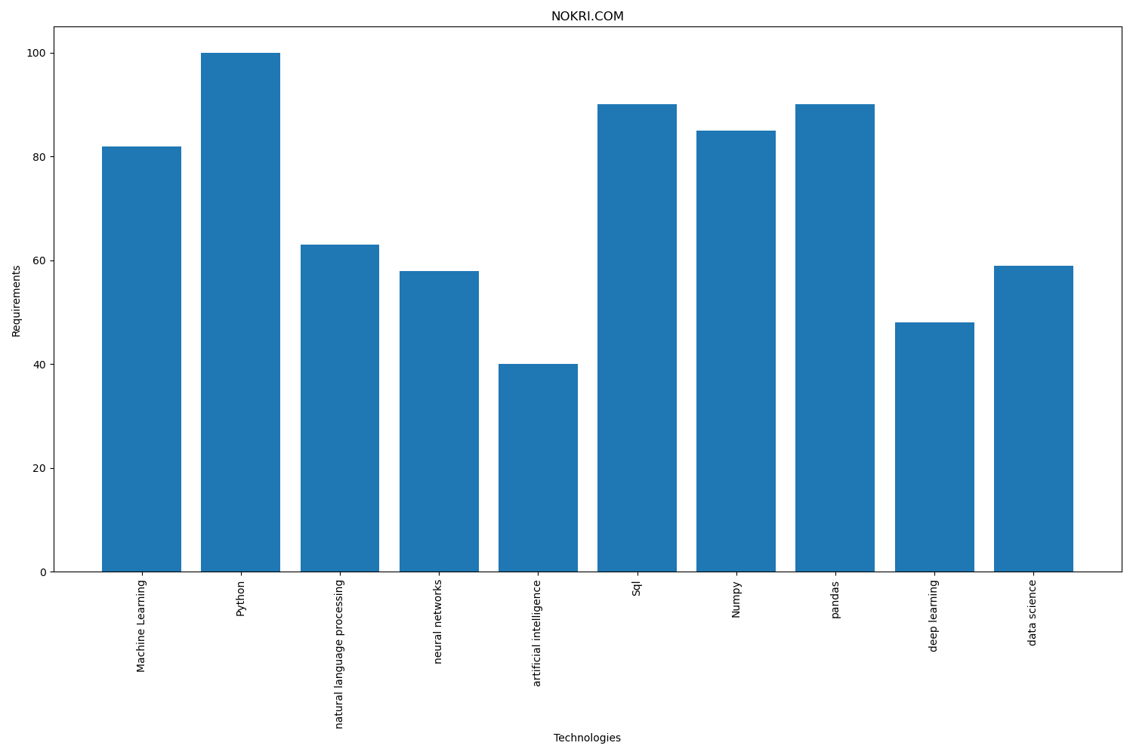

Slide 4
